Slide 1
Trump In A Far Way Scandal: A Murder Of Journalist!
How the assassination of Jamal Khashoggi affects the President..Party?
Friday Nov2,2018

Slide 2
Overview
Questions and assumptions to discuss:
What is the impact of the scandal on US?
How the murder affects Trump image and reputation?
Will this impact change the game in the midterm elections?
Why Now?
2018 midterm elections in the US will be held on Tuesday, November 6
Not the first media case against Trump administration
Trump was accused before on international case such as Russian troll tweets

Slide 3
( "Saudi Arabiya" OR "KSA" OR "Kingdom Saudi Arabia" ~ 3 OR "Saudi Arabia" ~ 2 OR "MBS" OR "Mohammad Bin Salman" ~ 2 OR "Crown Prince" OR "Son of King" ~ 3 ) AND ( "Jamal khashoggi" OR "journ
Q1: Impact on Trio: Trump, Saudi Arabia, MBS
QUERIES TO ANALYSE THE CASE:

Slide 4
Methodology
 | Clusters
● | Start of the crisis | 8.7%
● | US-KSA relationship | 7.4%
● | First reactions to the crime | 5.7%
● | Trump administration feedback | 5.3%
● | Financial impact: Skip "Davos In The Desert" | 4.9%
● | Trump VS Crown Prince | 4.9%
● | European Feedback: Weapons embargo | 4.6%
● | Trump increased pressure despite arms deal | 4.3%
● | Affection side: khashoggi's son leaves Saudi Arabia | 4.2%
● | Oil impact: Saudi Arabia uses the oil tool | 4.2%
● | Trump Threatens Saudi Arabia: severe punishment | 4.2%
● | Saudi reaction on Trump threats | 4.0%
● | Rumors on Khashoggi murder\ | 3.8%
● | Pompeo visit the Kingdom | 3.7%
● | Congress intervenes: Senators against the murder | 3.7%
● | Saudi Arabia confesses: Khashoggi killed in the embassy | 3.5%
● | Official announcement feedback: Top guys accused | 3.5%
● | Pressure to cancel The Middle East WWE Crown Jewel | 2.7%
● | Saudi defense strategy: officials statement anti-propaganda | 2.6%
● | Saudi Lobbies impact on Trump: The President changes his word | 2.3%
● | UK Intervention and sanction ahead: 10 Downing Street angry | 2.3%
● | Wrecking ball: US affirms Saudi allies | 2.1%
● | Trump changes his words again: Saudi Arabia lies | 2.1%
● | Saudi Arabia confirmed again the "grave mistake" | 2.0%
● | Trump relies on relation with Saudi Arabia and creating jobs | 1.8%
● | Saudi Arabia lobbies win more solidarity from Arab and Muslim countries | 1.5%
RENAME CLUSTERS BASED ON RELEVANT TOP QUERIES
REMOVE THE NON RELEVANT CLUSTERS (<1%)
Using Quid platform to analyze news and social media reviews
Findings:
>2400 articles and reviews
Significant correlation between the trio

Slide 5
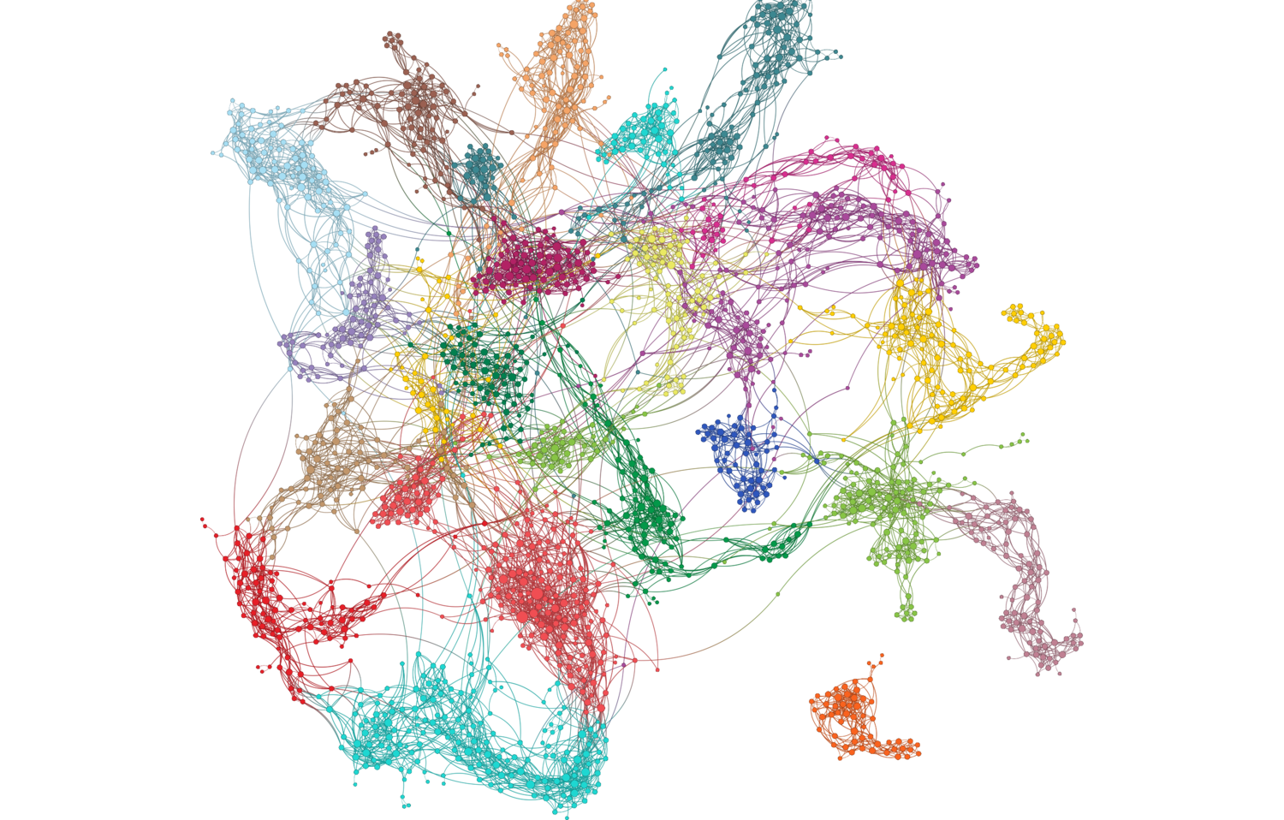
1 - Network Map on US, Trump and Saudi Arabiya?
Saudi reaction on Trump threats (4.0%)
Saudi Lobbies impact on Trump: The President ... (2.3%)
Trump Threatens Saudi Arabia: severe punishment (4.2%)
Saudi Arabia lobbies win more solidarity from Arab and ... (1.5%)
UK Intervention and sanction ahead: 10 Downing ... (2.3%)
Trump administration feedback (5.3%)
Pompeo visit the Kingdom (3.7%)
Rumors on Khashoggi murder\ (3.8%)
Official announcement feedback: Top guys accused (3.5%)
Saudi Arabia confirmed again the "grave mistake" (2.0%)
Financial impact: Skip "Davos In The Desert" (4.9%)
Saudi Arabia confesses: Khashoggi killed in the ... (3.5%)
Congress intervenes: Senators against the murder (3.7%)
Trump changes his words again: Saudi Arabia lies (2.1%)
Saudi defense strategy: officials statement ... (2.6%)
First reactions to the crime (5.7%)
Oil impact: Saudi Arabia uses the oil tool (4.2%)
Affection side: khashoggi's son leaves Saudi Arabia (4.2%)
Trump increased pressure despite arms deal (4.3%)
US-KSA relationship (7.4%)
Pressure to cancel The Middle East WWE Crown Jewel (2.7%)
Start of the crisis (8.7%)
Source: Quid®

Slide 6
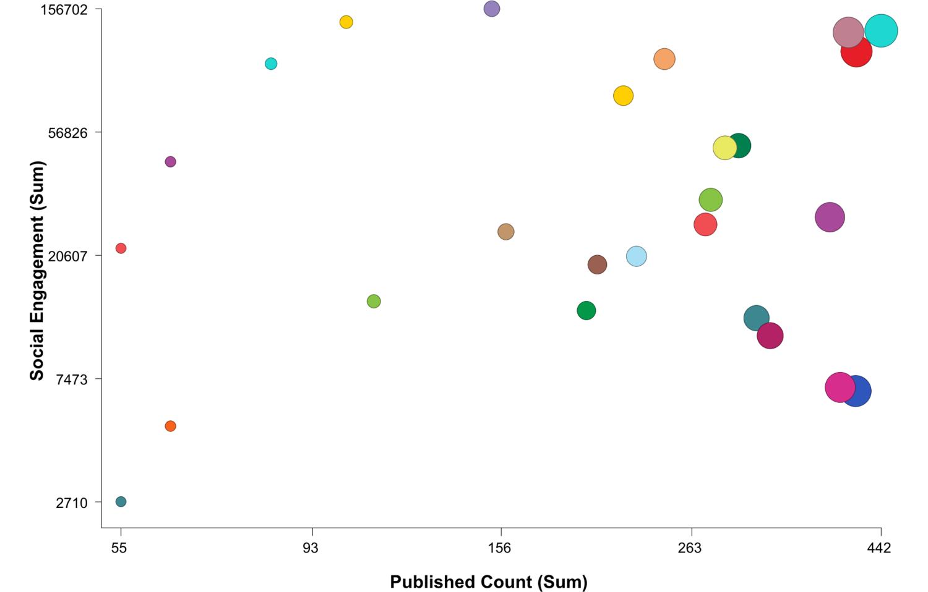
1.2:Social engagement vs. Published count
Official announcement feedback: Top guys accused
Start of the crisis
European Feedback: Weapons embargo
Financial impact: Skip "Davos In The Desert"
Saudi Arabia confirmed again the "grave mistake"
Saudi Arabia confesses: Khashoggi killed in the embassy
Congress intervenes: Senators against the murder
Trump administration feedback
Wrecking ball: US affirms Saudi allies
Trump Threatens Saudi Arabia: severe punishment
Oil impact: Saudi Arabia uses the oil tool
Pompeo visit the Kingdom
Saudi defense strategy: officials statement anti-propaganda
Pressure to cancel The Middle East WWE Crown Jewel
Saudi Arabia lobbies win more solidarity from Arab and Muslim countries
Source: Quid®

Slide 7
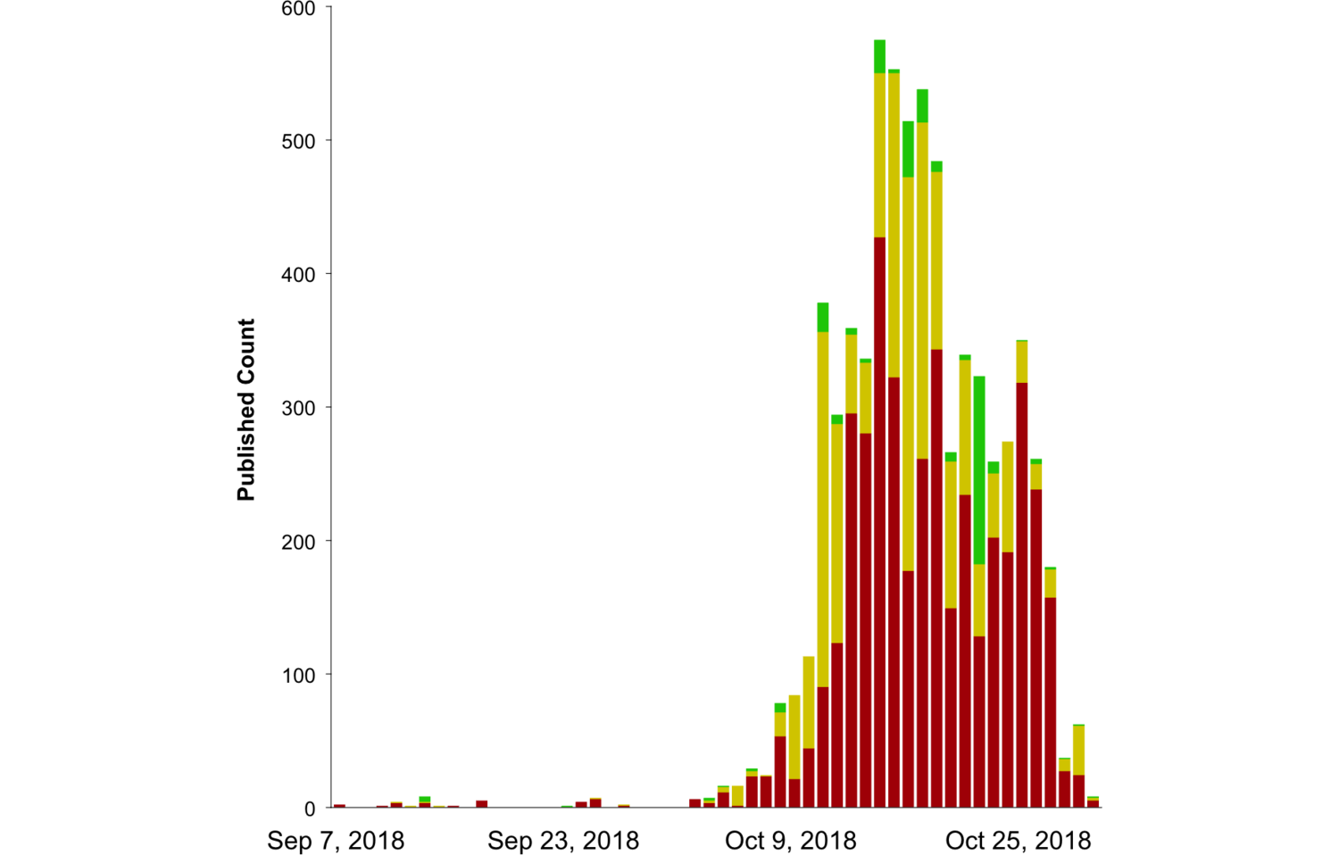
1.3 - Timeline by sentiment
 | Sentiment summary
● | negative | 62%
● | neutral | 32%
● | positive | 5.1%
Source: Quid®

Slide 8
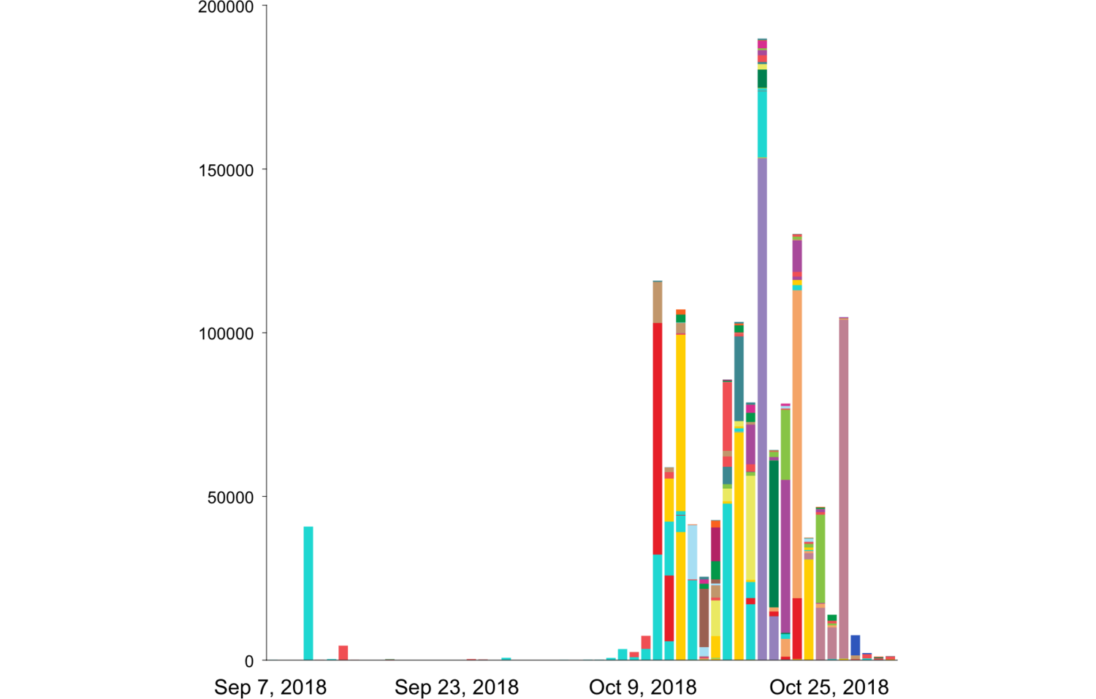
1.4 - Timeline of social engagement
 | Clusters
● | Start of the crisis | 8.7%
● | US-KSA relationship | 7.4%
● | First reactions to the crime | 5.7%
● | Trump administration feedback | 5.3%
● | Financial impact: Skip "Davos In The Desert" | 4.9%
● | Trump VS Crown Prince | 4.9%
● | European Feedback: Weapons embargo | 4.6%
● | Trump increased pressure despite arms deal | 4.3%
● | Affection side: khashoggi's son leaves Saudi Arabia | 4.2%
● | Oil impact: Saudi Arabia uses the oil tool | 4.2%
● | Trump Threatens Saudi Arabia: severe punishment | 4.2%
● | Saudi reaction on Trump threats | 4.0%
● | Rumors on Khashoggi murder\ | 3.8%
● | Pompeo visit the Kingdom | 3.7%
● | Congress intervenes: Senators against the murder | 3.7%
● | Saudi Arabia confesses: Khashoggi killed in the embassy | 3.5%
● | Official announcement feedback: Top guys accused | 3.5%
● | Pressure to cancel The Middle East WWE Crown Jewel | 2.7%
● | Saudi defense strategy: officials statement anti-propaganda | 2.6%
● | Saudi Lobbies impact on Trump: The President changes his word | 2.3%
● | UK Intervention and sanction ahead: 10 Downing Street angry | 2.3%
● | Wrecking ball: US affirms Saudi allies | 2.1%
● | Trump changes his words again: Saudi Arabia lies | 2.1%
● | Saudi Arabia confirmed again the "grave mistake" | 2.0%
● | Trump relies on relation with Saudi Arabia and creating jobs | 1.8%
● | Saudi Arabia lobbies win more solidarity from Arab and Muslim countries | 1.5%
Source: Quid®

Slide 9
Q.2:How the murder affects Trump image and reputation?
QUERIES of Analysis:
"trump" AND ("image" OR "reputation" OR "relation")

Slide 10
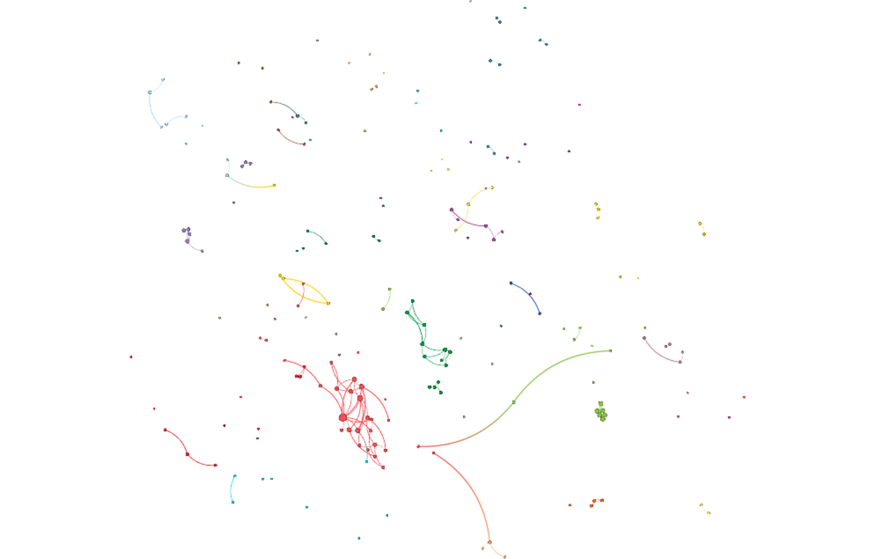
2.1 - Network map of Trump Reputation
Trump defends Saudi Arabia as accusations mount over journalist disappearance
Joint statement on the disappearance of Jamal Khashoggi
Financial impact: Skip "Davos In The Desert" (3.6%)
Boeing stands by Saudi Arabia, even now
An oil threat, but Saudi Arabia less fearsome than it used to be
First reactions to the crime (7.2%)
US-KSA relationship (13%)
The Khashoggi murder and the one-man rule of MBS

Slide 11
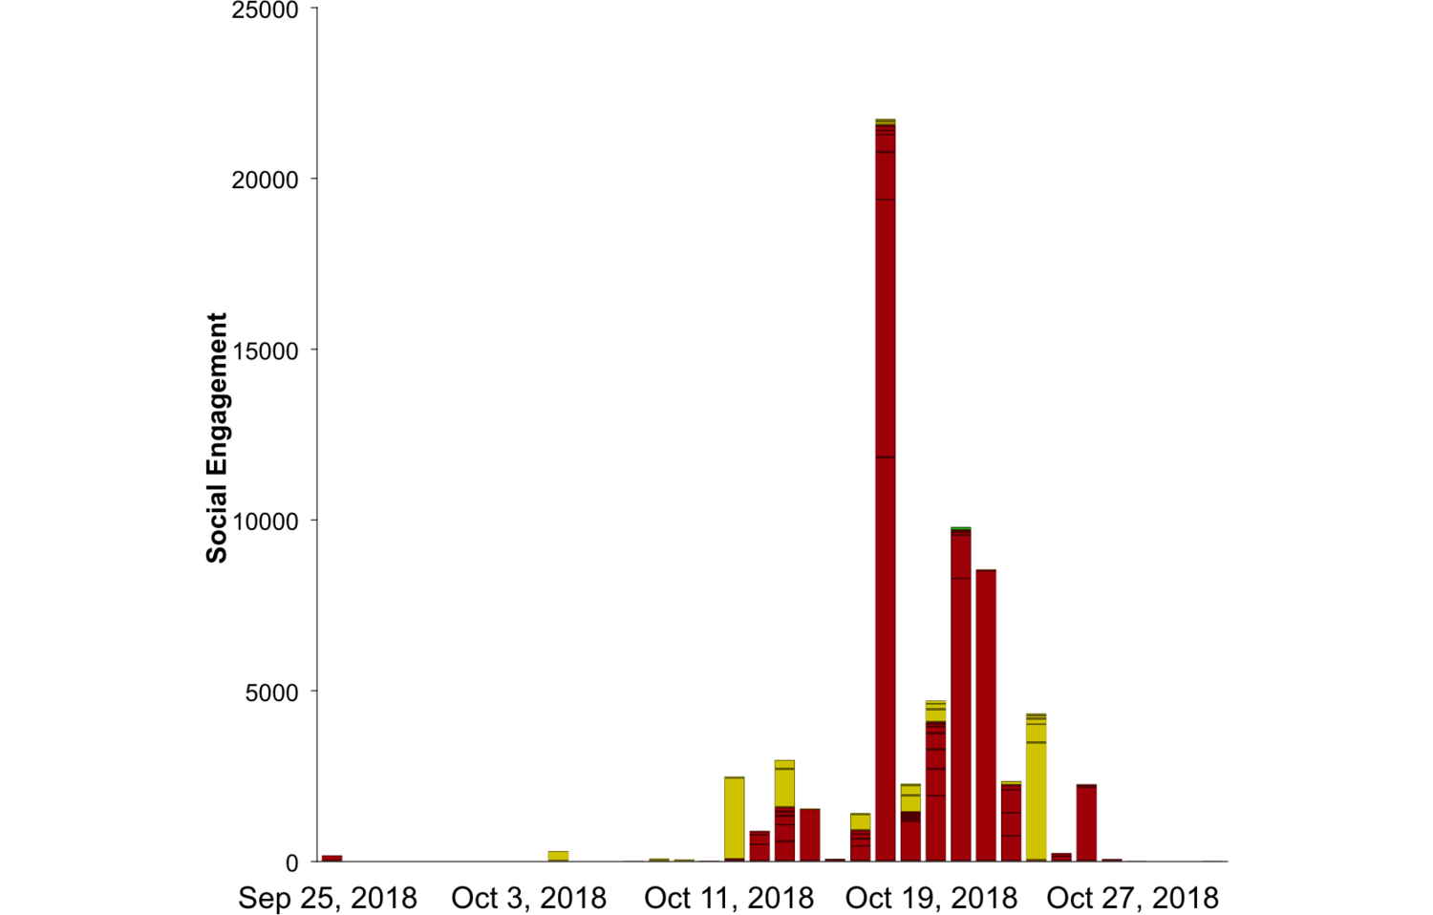
2.2 - Social Engagement by Sentiment
 | Sentiment summary
● | negative | 68%
● | neutral | 30%
● | positive | 1.1%
Source: Quid®

Slide 12
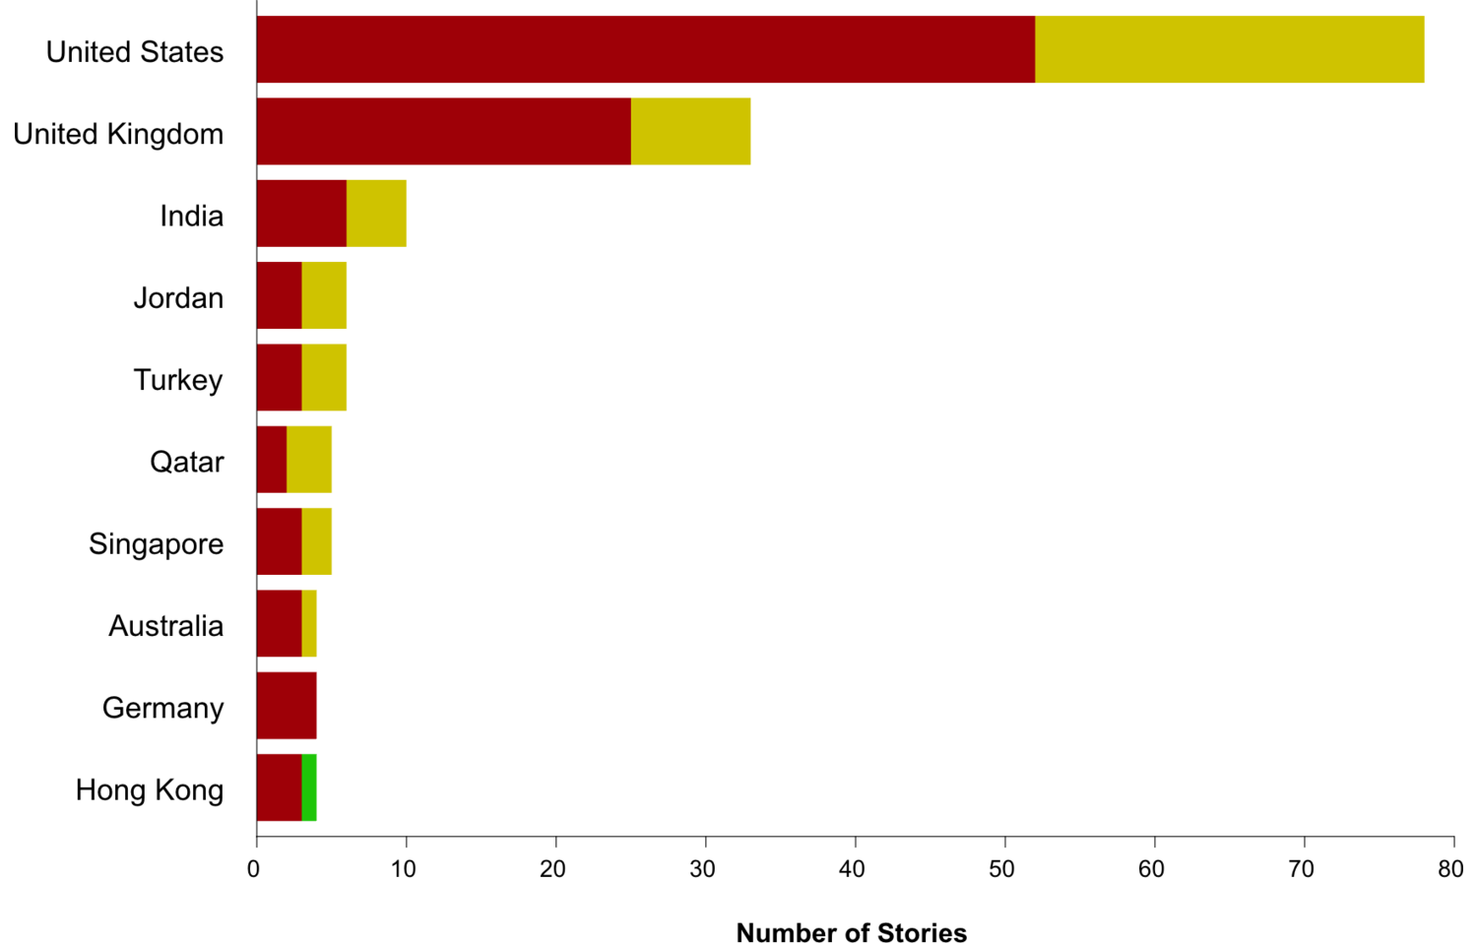
2.3 - Published count articles by countries
 | Sentiment summary
● | negative | 68%
● | neutral | 30%
● | positive | 1.1%
Source: Quid®

Slide 13
Findings
Trump administration played political games in human case (feedback is mostly negative)
US is maintaining its international relations for business reasons (queries found: more deals, more jobs, more foreign funds, etc...)
Republican Party might be affected negatively in the midterm election on Tuesday Nov6 because of the murder of Khashoggi
Based on the assumption above, Democrats will win more seats and more control

Slide 14
Appendix
Future Studies:
A- Politics Impact:
What is the impact of the scandal on Saudi Arabia?
To what extend the scandal will threat MBS?
What is the role of of AlJazeera and AlArabiya as Quatarian and Saudian media arm?
B- Economical impact:
How this International crime will affect the oil prices?
To what extent there is impact on US jobs and trade?
C- Media effects:
Pro and against media effects on Trump image?

Slide 15
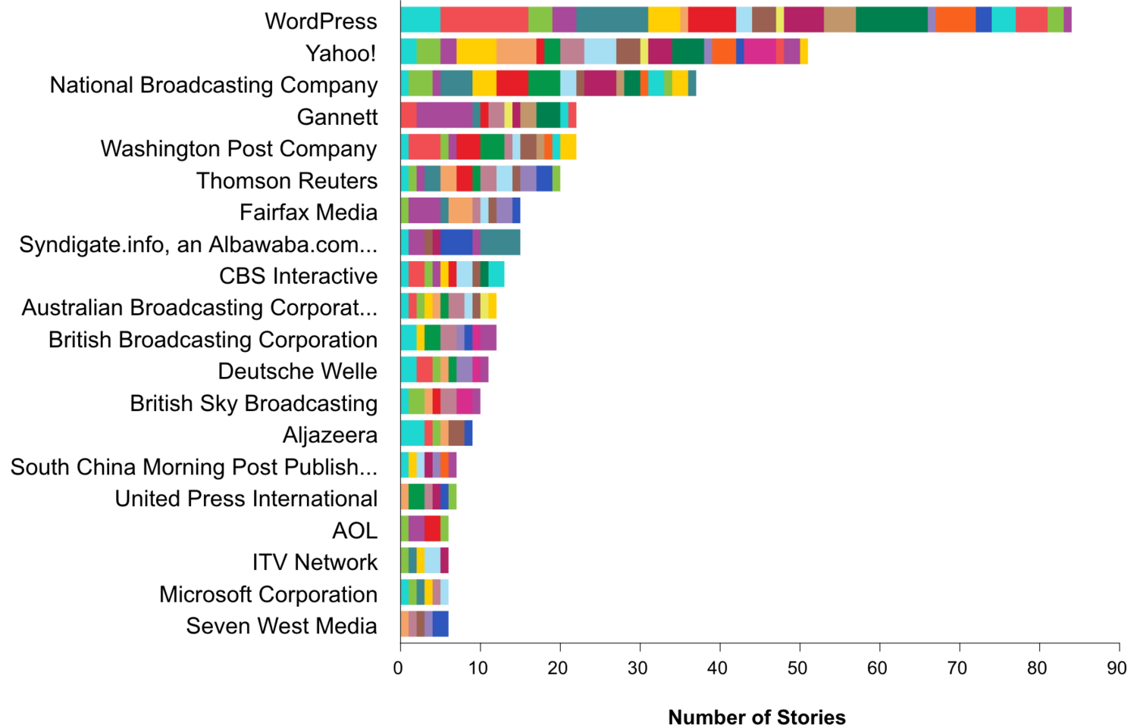
A.1 - Top 20 news sources
 | Clusters
● | Start of the crisis | 8.7%
● | US-KSA relationship | 7.4%
● | First reactions to the crime | 5.7%
● | Trump administration feedback | 5.3%
● | Financial impact: Skip "Davos In The Desert" | 4.9%
● | Trump VS Crown Prince | 4.9%
● | European Feedback: Weapons embargo | 4.6%
● | Trump increased pressure despite arms deal | 4.3%
● | Affection side: khashoggi's son leaves Saudi Arabia | 4.2%
● | Oil impact: Saudi Arabia uses the oil tool | 4.2%
● | Trump Threatens Saudi Arabia: severe punishment | 4.2%
● | Saudi reaction on Trump threats | 4.0%
● | Rumors on Khashoggi murder\ | 3.8%
● | Pompeo visit the Kingdom | 3.7%
● | Congress intervenes: Senators against the murder | 3.7%
● | Saudi Arabia confesses: Khashoggi killed in the embassy | 3.5%
● | Official announcement feedback: Top guys accused | 3.5%
● | Pressure to cancel The Middle East WWE Crown Jewel | 2.7%
● | Saudi defense strategy: officials statement anti-propaganda | 2.6%
● | Saudi Lobbies impact on Trump: The President changes his word | 2.3%
● | UK Intervention and sanction ahead: 10 Downing Street angry | 2.3%
● | Wrecking ball: US affirms Saudi allies | 2.1%
● | Trump changes his words again: Saudi Arabia lies | 2.1%
● | Saudi Arabia confirmed again the "grave mistake" | 2.0%
● | Trump relies on relation with Saudi Arabia and creating jobs | 1.8%
● | Saudi Arabia lobbies win more solidarity from Arab and Muslim countries | 1.5%
Source: Quid®

Slide 16
Questions?
Thank you!

Slide 17
Text Analytics Background

Slide 18
How to Read a Network
Quid creates a visual map to represent the landscape. Example network: sized by degree, colored by cluster.

